Slide 1


How might we help disadvantaged youth gain the skills required to get a job?
Notes:
Our challenge in partnership with Bloomberg: How might we help disadvantaged youth gain the skills required to get a job?

Slide 2

THIS IS US…
Narrative
Michael MBA
Mike
CS
Vincent
CS
Yi
Design
Andy
CM
Notes:
This is us… but this is not about us

Slide 3
…THIS IS ABOUT ANA
Motivations
Wants to work in technology
Family is her main source of strength
Enjoys helping others
Pain Points
No resources to learn new skills
No guidance on potential career paths
No mentors to connect and engage
Ana
21 years old
First generation immigrant from Mexico
Works as a barista and nanny
Notes:
This is about Ana…
Think about your own life experiences. Probably all of us here has had opportunities to get a degree, and have mentors that can guide us to various opportunities. What hopefully doesn’t surprise you is that millions of young people live in a different world – one that instead of lifting you up, it’s adamant to bring you down.
Ana is exactly that… working as a barista making $9.76 an hour and has to supplement by working a second shift. And this is not even the worst of stories.

Slide 4
DID YOU KNOW?
In NYC
Tech Industry
44.2%
in or near the poverty line
100K tech jobs
to be created in the next 10 years
10.1%
of 18-29 years old don’t have a job or enrolled in school
44%
of these jobs don’t require a college degree
Notes:
What might surprise you is that, we are looking at NYC from this campus while almost half of the population lives in poverty. The unemployment rate of 18-29 year olds is 10.1%, higher than the country average of 8.3%, which doesn’t account for many that want better jobs but don’t get the chance.
So we solve this by “piggy-backing off” the growth in the tech industry. There is already a plan in place to create 100k tech jobs over the next 10 years, and 44% of these jobs don’t required a college degree… and they also pay 45% more than the average.

Slide 5
A LONG, DIFFICULT JOURNEY
Discover
Goal
Plan
Learn
Job
33+ learners and professionals interviewed
which informed our solution
Notes:
These users face a long and difficult journey, from discovering their career to actually getting a job. So we did pretty extensive research, interviewing over 33 learners and professionals in the industry to understand their motivations and pain points as it relates to this journey. This highly informed our solution to this issue…

Slide 6







OUR FOUR PILLARS
Solve a problem
Gamification
Great user experience
Emotional connection
Notes:
…which coupled with our four pillars: solve a problem, great UX, gamification and emotional connection, we strive to make a difference and create a one in a kind community for disadvantaged youth

Slide 7
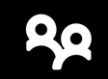
JoB Buddy
Learn | Connect | Engage
Aprende | Conéctate | Participa
Notes:
We present you “Job Buddy”…
Go into demo & related research findings

Slide 8


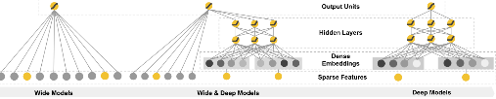
ARCHITECTURE DIAGRAM
MongoDB
Web Browser
Crawler
Data Pipeline
View
Model
Control

Slide 9
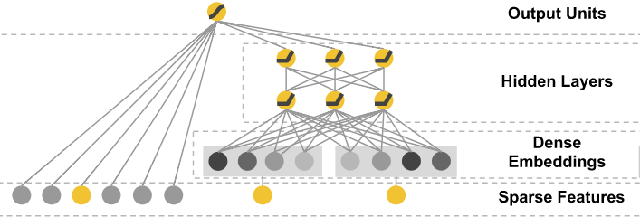
MATCHING – WIDE FFM IN THE DEEP
Field-aware Factorization Machines

Slide 10
NEXT STEPS
Continue validation and testing
Iterate based on user feedback, particularly within the online courses
Test additional features to enhance the user experience
Connect back-end stack with user interface

Slide 11
QUESTIONS?
Michael | Mike | Vincent | Yi | Andy

Slide 12
APPENDIX

Slide 13
RESEARCH FINDINGS
“I had no chance to learn the skills required”
“Difficult to learn on my own”
Career discovery
50% discovered their careers through their connections
Jobs in tech
Most useful skill
Learning hard skills
Access to mentors
Hardest skill
Access to mentors
Online courses
73% of professionals found mentoring had a positive impact in their careers
Learning hard and soft skills including interview (both 22.25%, in total 45%), connections to professionals (41%). If they came from disadvantaged background : learning hard skill, prepare interviews.
Lack of feedback & guidance
Mentorship

